Slide 1
PBPK/PD Modeling of Key Events in a Toxicity Pathway - Implications for Determining Population Thresholds
Paul S. Price, The Dow Chemical Company
Daland R. Juberg, Dow AgroSciences
Michael J. Bartels, The Dow Chemical Company
Society of Toxicology
San Francisco, CA
March 14, 2012

Slide 2
Topics
Description of Exposure/PBPK/PBPD modeling
Key findings
Assessing the impact of background exposures and disease processes on dose response for apical effects

Slide 3
Chlorpyrifos-ethyl
Widely used active ingredient in insect control products for agriculture (registered in 1965; 100 countries globally)
Extensive toxicological database including:
Full toxicological database for global registrations
Occupational exposure and health monitoring data
Epidemiology studies
Toxicological mode of action and endpoint upon which human exposure limits are based is cholinesterase inhibition (ChEI)

Slide 4
Project description
ACC/LRI request for proposals to use science to advance risk assessment (2007)
Goal: replace safety factors with quantitative predictions of adverse effects
Two publications (Price et al., 2011; Hinderliter et al., 2011)
Project was expanded in 2010 to address new data on variation in human metabolism
Subject of EPA Science Advisory Panel meeting February 2011

Slide 5
What was done?
Created a source-to-outcome model that evaluates the relationship between dietary residues in food and impact on ChEI in exposed populations.
Dietary model estimates variation in daily doses for adults and infants
PBPK/PD model predicts variation in human sensitivity to chlorpyrifos (across individuals and across ages)
The focus on ChEI is an example of the upstream ‘obligatory perturbation’ concept described in the NAS Toxicity Testing in the 21st Century (2007)

Slide 6
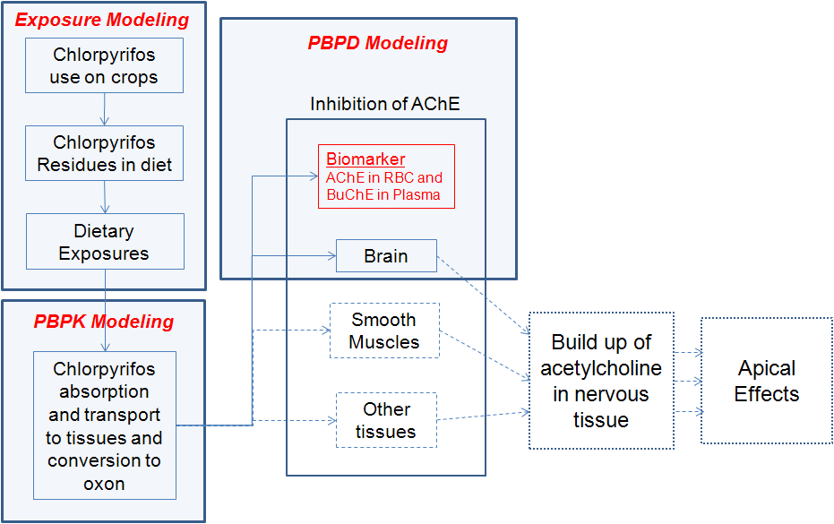
Description of modeling

Slide 7
Key findings
Focus on Red Blood Cell Acetyl Cholinesterase Inhibition (RBC AChEI)

Slide 8
High-dose prediction of response of RBC AChEI: adults and infants (age 6 months)

Slide 9
High-dose prediction of response of RBC AChEI: adults and infants (age 6 months)

Slide 10
Distributions of daily dietary doses in adults and infants (age 6 months)

Slide 11
Distributions of daily dietary doses in adults and infants (age 6 months)

Slide 12
Predicted impact on RBC AChE after five days of exposure in adults and infants

Slide 13
Predicted impact on RBC AChE after five days of exposure in adults and infants

Slide 14
Implications for the occurrence of apical effects
RBC AChEI is a conservative marker for CNS AChEI
Short-term fluctuations of individuals’ AChEI levels are more than ±10% in the general population
AChEI inhibition levels of 35%-90% are required before apical effects are observed (Nigg and Knaak, 2000)
Predicted impacts on AChEI from dietary exposures are more than three orders of magnitude lower than the above values (maximum effect is < 0.01% inhibition)
Conclusion: AChEI-mediated effects are unlikely to occur in individuals from dietary exposures to chlorpyrifos

Slide 15
NAS report “Science and Decisions”
Non-cancer risk assessments need to consider the impacts of other stressors and other disease

Slide 16
“Science and Decisions”
“The assessment of ‘background exposure’ and ‘background disease processes’ would involve characterization of other chemicals or nonchemical stressors that influence the same general pathologic processes as the chemical under evaluation.” (Pg. 139)
“Effects of exposures that add to background processes and background endogenous and exogenous exposures can lack a threshold if a baseline level of dysfunction occurs without the toxicant and the toxicant adds to or augments the background process. Thus, even small doses may have a relevant biologic effect.” (Pg. 130)
Figure 5-4 NRC, 2010

Slide 17
Apical effects of cholinesterase inhibition
Accumulation of acetylcholine in tissues results in a range of effects (DUMBBELSS)
Diarrhea, Urination, Miosis/muscle weakness, Bronchorrhea, Bradycardia, Emesis, Lacrimation, and increased Salivation/Sweating
A background frequency of occurrence of many of these effects exists at any point in time in the general population
Due to a wide range of stressors (diet, pathogens, etc.)

Slide 18
Key Question
Do these background rates of apical effects indicate a linear dose-response for chlorpyrifos and the occurrence of effects from current dietary exposures?
The source-to-outcome model provides critical information on this point
Occurrence of apical effects
and
Occurrence of obligatory precursor effects

Slide 19
At current exposures to dietary residues
Apical effects do not occur, and
Acetylcholine build up does not occur, and
Inhibition of AChE does not occur
Therefore at low doses chlorpyrifos does not increase the chance of apical effects even in marginal individuals

Slide 20
Summary and conclusions
A source-to-outcome model was created for chlorpyrifos and ChEI-mediated effects. The model indicates changes in ChE from dietary exposures are 1000-fold smaller than changes associated with apical effects.
S&D suggests “background exposures and underlying disease states” will always result in a linear low dose response for noncancer effects; however, the demonstration of a threshold for precursor effects provides a justification for a population threshold for the apical effects of chlorpyrifos.

